Slide 1
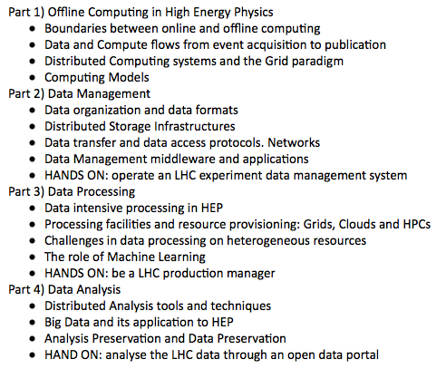
Some words first..
From the Syllabus
I will cover this part of the course
50% of the lecture will happen in the
informatic lab (for some hands-on)
What we do in the lab is part of the
course (and the exam)
Some of the items will require more
time (and some less)

Slide 2
Some words first..
I am visiting professor at the University of Padova for this semester. I am not based in Padova
I will be here (and you will have lectures with me):
March 13 (Today)
April 17, 18
May 22, 23
June 6
You can fix an appointment with me F2F at any time in those days (outside lecture hours). You can fix an online chat at other times
Simone.Campana@cern.ch
Skype: gerico1975 WhatsApp: +41 754110299

Slide 3
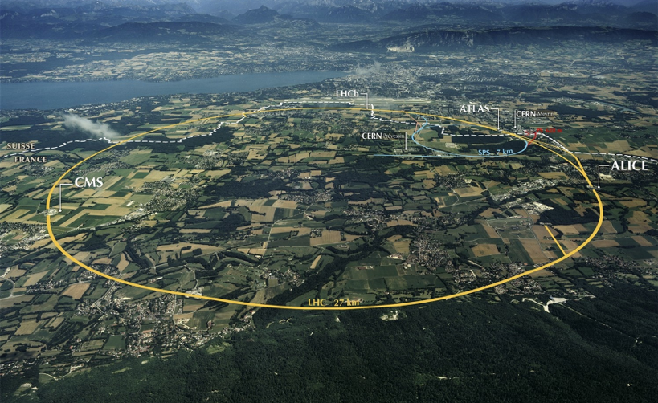

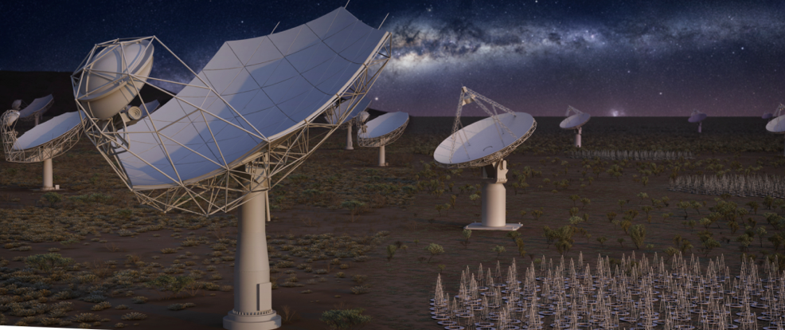
The challenges in Management and Analysis of Physics Data
Simone Campana
CERN
Padova, March 2019
With a strong focus on High Energy Physics

Slide 4
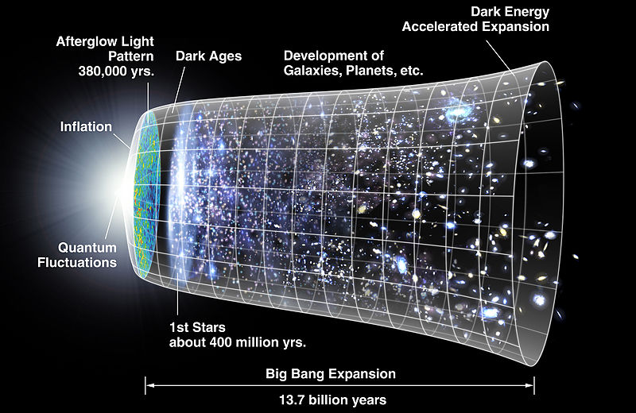
Evolution of the Universe
LHC drivers
Test the Standard
Model?
Dark Matter?
Dark Energy?
Anti-matter?
(Gravity?)

Slide 5
The Large Hadron Collider @ CERN

Slide 6
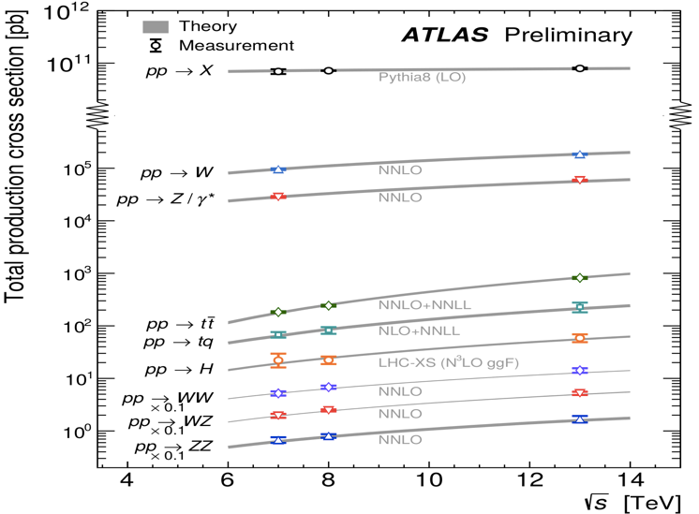
How likely something interesting happens?
Total Production Cross Section (== probability) vs Energy in pp collisions
Notice the logarithmic scale on the Y-axis: it spans 11 orders of magnitude
E.g. you produce 10 Higgs bosons out of 10**11 billions of collisions
The probability increases logarithmically with energy
Theory (lines) agrees very well with measurements (markers)

Slide 7
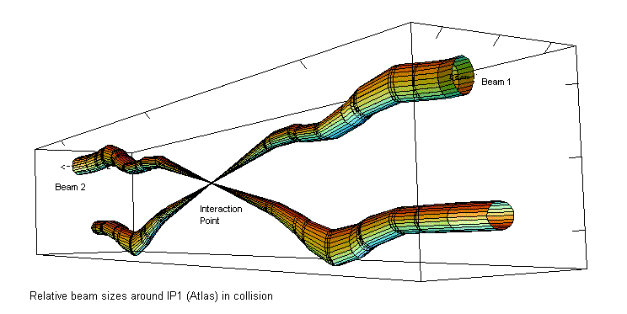
What is an event?
A crossing of the two LHC proton beams at an interaction point

Slide 8
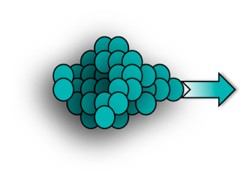
What is an event?
Proton bunches
>10¹¹ protons/bunch
colliding at 13 TeV and at ~40 MHz in 2018
In 2018:
Up to 60 p-p collisions / bunch crossing
Notes:
The detector sees about 50 simultaneous collisions happening at a rate of 30 MHz…
This is a huge data volume for the ATLAS detector to read out. Taking also into account that each collision produces data of about 1.5MB in size, this would correspond to 45 TBytes of data produced per second. This is a huge number of events to store, but also to process. Furthermore most of these events are not really interesting for analysis. So we need a way to select which of all these 30MHz of events to keep.
----------

Slide 9
The Large Hadron Collider @ CERN
New Particle!
(<<mHz?)
p-p collisions with interesting parton interactions
(<kHz)
p
p
~40 p-p collisions/bc
Proton bunches
>10¹¹ protons/bunch
(colliding at ~40MHz)

Slide 10
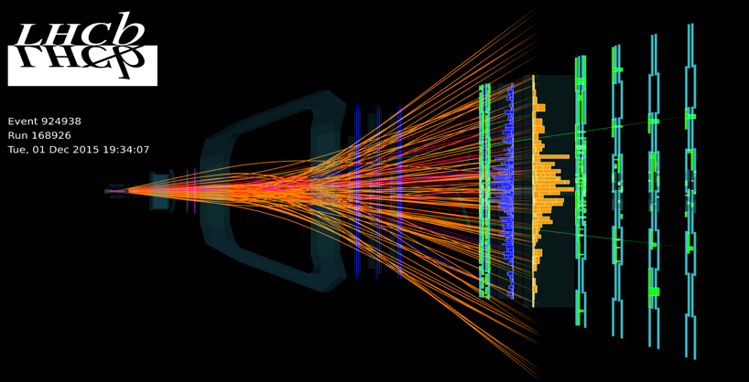
In fact an event looks like this …

Slide 11
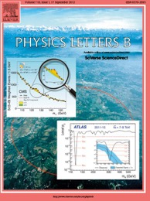
How do we deal with physics events
from when they leave the detector
till when they make it into our publications?
Publication
?
Detector

Slide 12





An event’s lifetime
Data preparation,
Reconstruction & Calibration
Detector
Trigger
Publication
Data analysis
Theory / Simulations
Background
# events
Signal
Signal
Relevant quantity
Notes:
Triggering is the first processing step of the event that is created at the center of the detector after the collision has occurred. If the trigger decides for the event to be accepted for further processing, the event moves to disk. The data get reconstructed and calibrated such that we can trust what we are measuring. On parallel, we generate simulated data that describes what the standard model signals should look like on the detector, or how new physics signals should look like. We feed our detector data and our simulated data to analyses that we develop, often using sofisticated analysis techniques. The results of these analyses is what makes our physics publications.
----------

Slide 13
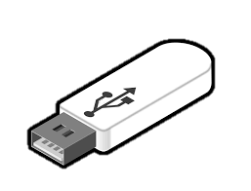
An event’s lifetime
Data preparation,
Reconstruction & Calibration
Detector
Trigger
Publication
Data analysis
Theory / Simulations
Background
# events
Signal
Signal
Relevant quantity
Notes:
Triggering is the first processing step of the event that is created at the center of the detector after the collision has occurred. If the trigger decides for the event to be accepted for further processing, the event moves to disk. The data get reconstructed and calibrated such that we can trust what we are measuring. On parallel, we generate simulated data that describes what the standard model signals should look like on the detector, or how new physics signals should look like. We feed our detector data and our simulated data to analyses that we develop, often using sofisticated analysis techniques. The results of these analyses is what makes our physics publications.
----------

Slide 14





Triggering on physics
LHC collisions
The ATLAS / CMS paradigm in “Run2”
40 MHz
L1
HLT
~100kHz
~1kHz
Notes:
This is where the trigger comes in, a system that is programmed to take this decision for us. A first layer, with selection logic encoded on fast electronics, provides a less than 0.5% acceptance. The data is passed on to a large CPU farm, the High Level Trigger, which is running fast algorithms to take the final decision. In the end about 1 in 30’000 events are stored for further processing.
----------
----------
The trigger helps the selection of interesting events, but also applies upper limits in the number of events we can select at each of its steps.
----------
Total inelastic x-section at the LHC, ~ 100 mbarn
Total higgs cross section at the LHC, ~ 55 pbarn

Slide 15
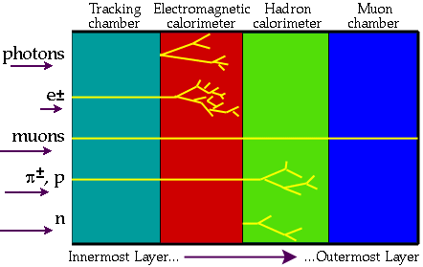
Particles through matter

Slide 16
A Detector (e.g. ATLAS)
Simplified Detector Transverse View
Muon Spectrometer
Toroids
HadCAL
EMCAL
Solenoid
TRT
SCT
Pixels
photon
electron
Jet
ν
muon

Slide 17
online reconstruction
electron
electron
electron
Jet
Jet
Jet
Jet
Jet

Slide 18
Triggering on physics
electron
electron
electron
✔
✔
Jet
Jet
Jet
✔
✔
✘
Jet
Jet

Slide 19
What do RAW data contain?
Detector
Trigger

Slide 20

An event’s lifetime
Every 25 ns
Day(s) - Month(s)
2.5 μs
~0.3 s
Data preparation,
Reconstruction & Calibration
Detector
Trigger
Publication
Year(s)
Month(s) - Year(s)
Data analysis
Theory / Simulations
Background
# events
Signal
Signal
Relevant quantity
Year(s)
Notes:
An interesting aspect of this schema is the time every step takes. Collisions occur every 25 ns. The hardware trigger takes 2.5 μs to process the event and decide whether to keep it or not. The HLT takes about 300 ms. This constitutes what we call the “online” processing, and as you can see, it’s happening effectively “real time”. Anything beyond that processing step is happening “offline”.
----------

Slide 21
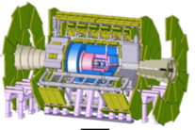
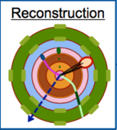
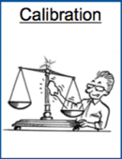
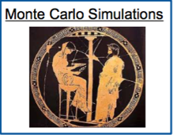
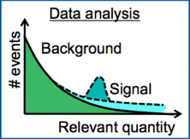
HEP Computing: make “Big Data” into “Useful Data”
~40 MHz
~ PB/s
“Online” – Real time
Funded as part of the detector
L1 Trigger (HW)
HL Trigger (SW)
~100 kHz
~1 kHz
“Raw Data” ~ 1-10 GB/s
“Offline” - Asynchronous

Slide 22
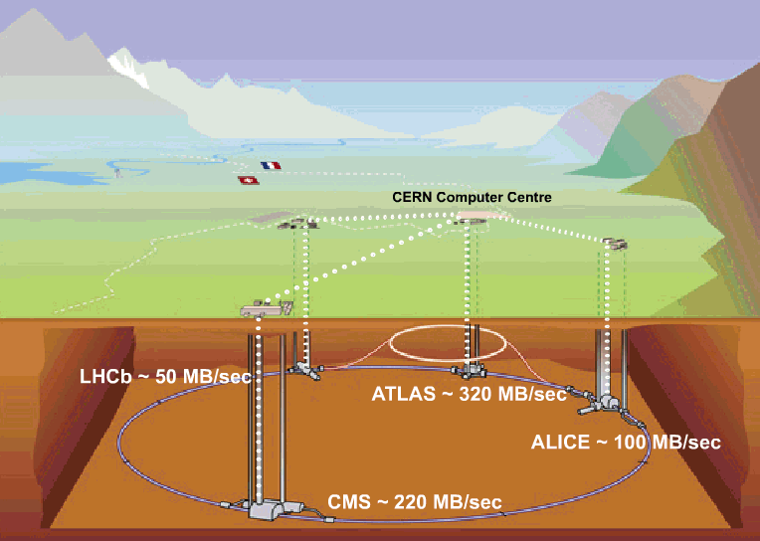
CERN Computer Centre (Tier-0): Acquisition, First pass reconstruction, Storage & Distribution
CERN Computer Centre: Acquisition, Reconstruction, Storage & Distribution
LHCb ~50 MB/sec
2017: ~700 MB/sec
ATLAS ~320 MB/sec
2017: ~1 GB/sec
ALICE 1.25 GB/sec (ions)
2017 ~4GB/sec
CMS ~220 MB/sec
2017 ~600 MB/sec
Notes:
Red boxes: indicate the planning figures before LHC startup
Green boxes: indicate the actual figures prior to LS1
ALICE: 4 GB/s (Pb-Pb running)
ATLAS: 800MB/s - 1 GB/s
CMS: 600 MB/s
LHCb: 750 MB/s

Slide 23
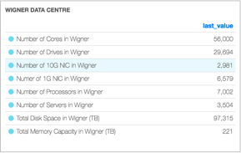
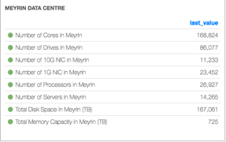
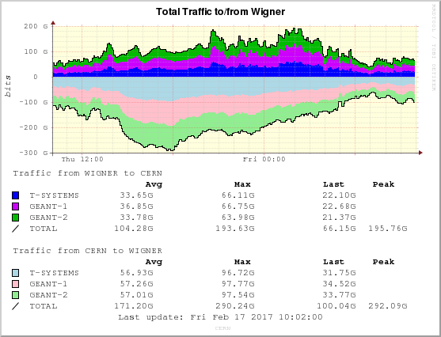
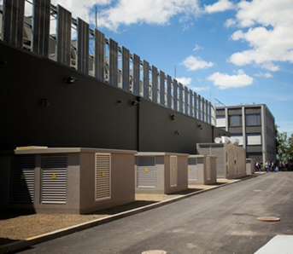
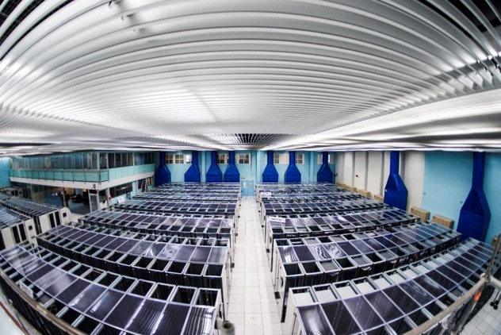
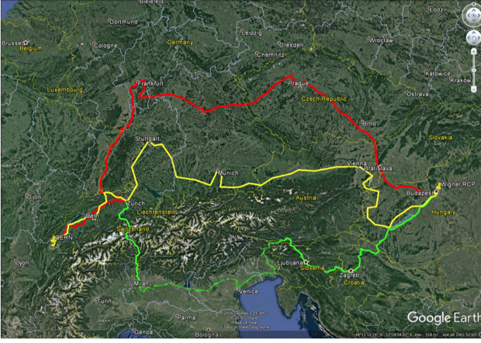
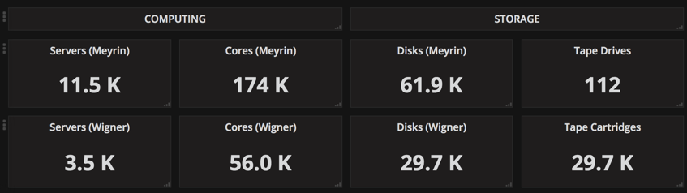
CERN Facilities today
~150 PB usable space

Slide 24

The event reconstruction
t
Express Stream Reconstruction
RAW
Express
stream
Best-effort calibrations
1st Update
Calibration
streams
Calibration, alignment, noisy cells
~48h
Final calibrations
Physics stream
Bulk data
processing
2nd Update
~1week
AOD
(Analysis Object Data)
Physics stream
Bulk data
re-processing
Offline conditions
O(months)

Slide 25
What do we reconstruct
Simplified Detector Transverse View
Muon Spectrometer
Toroids
HadCAL
EMCAL
Solenoid
TRT
SCT
Pixels
Tracks and
Clusters
photon
electron
Combining those:
“objects”
(“particles”)
Jet
ν
muon

Slide 26
Tracking in a NUTSHELL – Track fitting
Perfect measurement – ideal
Imperfect measurement – reality
Small errors and more points help to constrain the possibilities
Quantitatively:
Parameterize the track;
Find parameters by Least-Squares-Minimization;
Obtain also uncertainties on the track parameters.

Slide 27
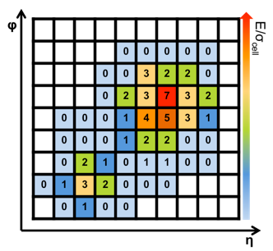
Clustering in a nutshell
Reconstruct energy deposited in the calorimeter by charged or neutral particles; electrons, photons and jets.
For a cluster we measure:
The energy;
The position of the deposit;
The direction of the incident particles;
Calorimeters are segmented in cells.
Typically a shower created by a particle interacting with the matter extends over several cells.
Various clustering algorithms, e.g.:
Sliding window. Sum cells within a fixed-size rectangular window.
Topo-clustering. Start with a seed cell and iteratively add to the cluster the neighbor of a cell already in the cluster.

Slide 28
What do we reconstruct
Simplified Detector Transverse View
Muon Spectrometer
Toroids
HadCAL
EMCAL
Solenoid
TRT
SCT
Pixels
Tracks and
Clusters
photon
electron
Combining those:
“objects”
(“particles”)
Jet
ν
muon

Slide 29
An event’s lifetime
Data preparation,
Reconstruction & Calibration
Detector
Trigger
Publication
Data analysis
Theory / Simulations
Background
# events
Signal
Signal
Relevant quantity
Notes:
Triggering is the first processing step of the event that is created at the center of the detector after the collision has occurred. If the trigger decides for the event to be accepted for further processing, the event moves to disk. The data get reconstructed and calibrated such that we can trust what we are measuring. On parallel, we generate simulated data that describes what the standard model signals should look like on the detector, or how new physics signals should look like. We feed our detector data and our simulated data to analyses that we develop, often using sofisticated analysis techniques. The results of these analyses is what makes our physics publications.
----------

Slide 30
Monte Carlo Simulation – Why
We only build one detector.
How do we compromise physics due to detector design?
How would a different detector design affect measurements?
How does the detector behave to radiation?
In the detectors we only measure voltages, currents, times.
It’s an interpretation to say that such-and-such particle caused such-and-such signature in the detector.
Simulating the detector behavior we correct for inefficiencies, inaccuracies, unknowns.
We need a theory to tell us what we expect and to compare our data against.
A good simulation is the way to demonstrate to the world that we understand the detectors and the physics we are studying.

Slide 31
Monte Carlo Production chain
Event Generation
simulate the physics process.
Detector Simulation
simulate the interaction of the particles with the detector material.
Digitization
Translate interactions with detector into realistic signals.
Reconstruction
Go from signals back to particles, as for real data.

Slide 32
Monte Carlo Production chain
How much processing time needed for each step?
Event Generation
simulate the physics process.
From < 1s to a few hours / event.
Detector Simulation
simulate the interaction of the particles with the detector material.
From 1 to 10min / event
Digitization
Translate interactions with detector into realistic signals.
From 5 to 60s / event
Reconstruction
Go from signals back to particles, as for real data.

Slide 33
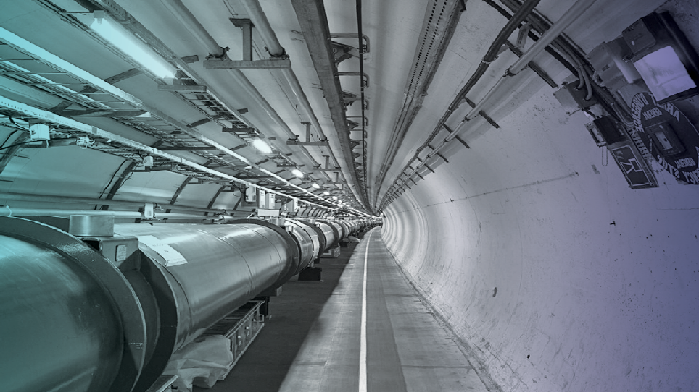
The Scale of the LHC Computing Problem
1 PB/s of data generated by the detectors
Up to 60 PB/year of stored data
Large experiments have managed data sets of >200 PB
One Million cores working 24/7
Would put us amongst the top Supercomputers if centrally placed: est. 10-20 Pflops
More than 100 PB/month moved and accessed by 10k people
Notes:
Particle physics is and has been a leader with some of the largest scientific data samples produced

Slide 34
What is ”computing” BTW?
“Computing is any activity that uses computers.”
“Computing is the process of using computer technology to complete a given goal-oriented task. Our goal is “science”.
Grid Computing is a model involving a distributed architecture of large numbers of loosely coupled computational and storage resources connected to solve a complex problem

Slide 35
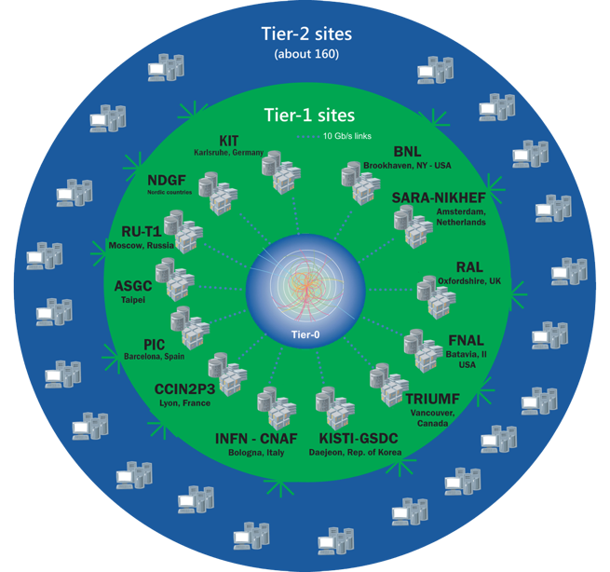
The Worldwide LHC Computing Grid
Tier-0 (CERN and Hungary): data recording, reconstruction and distribution
~170 sites, 42 countries
~750k CPU cores
Tier-1: permanent storage, re-processing,
analysis
~1 EB of storage
> 2 million jobs/day
Tier-2: Simulation,
end-user analysis
10-100 Gb links
WLCG:
An International collaboration to distribute and analyse LHC data
Integrates computer centres worldwide that provide computing and storage resource into a single infrastructure accessible by all LHC physicists

Slide 36
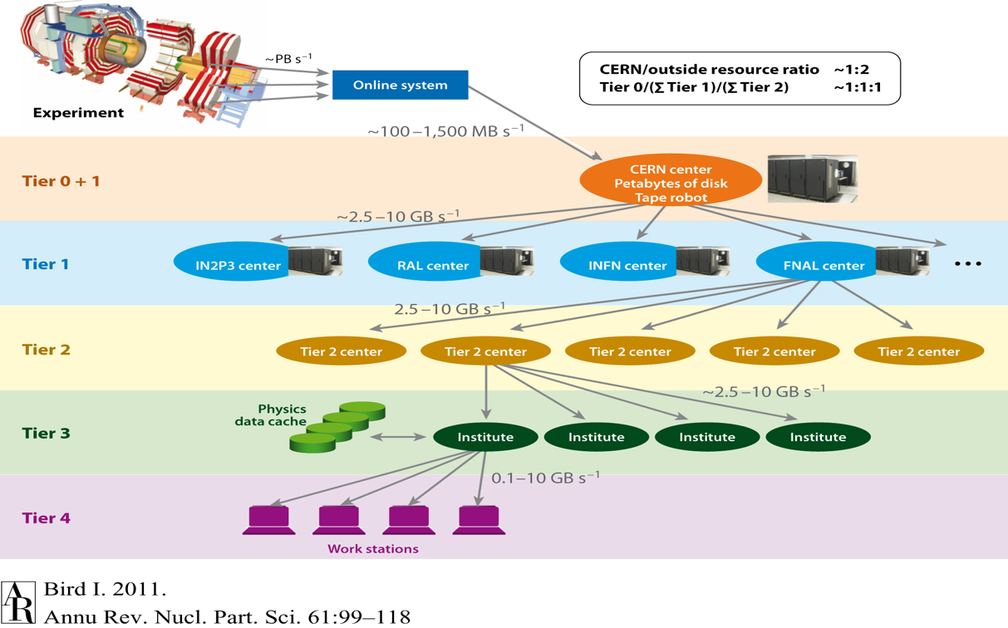

Slide 37
T2
Wide Area Network
T1
Local Network
T2
disk
storage
archive
storage

Slide 38
The Scale of the LHC Computing Problem
1 PB/s of data generated by the detectors
Up to 60 PB/year of stored data
Large experiments have managed data sets of >200 PB
A distributed computing infrastructure
of order of a million cores working 24/7
An average of 60M jobs/month
An continuous data transfer rate of 35 GB/s
(3 PB/day) across the Worldwide LHC Grid (WLCG)
Would put us amongst the top Supercomputers if centrally placed: est. 10-20 Pflops
More than 100 PB/month moved and accessed by 10k people
Notes:
Particle physics is and has been a leader with some of the largest scientific data samples produced

Slide 39
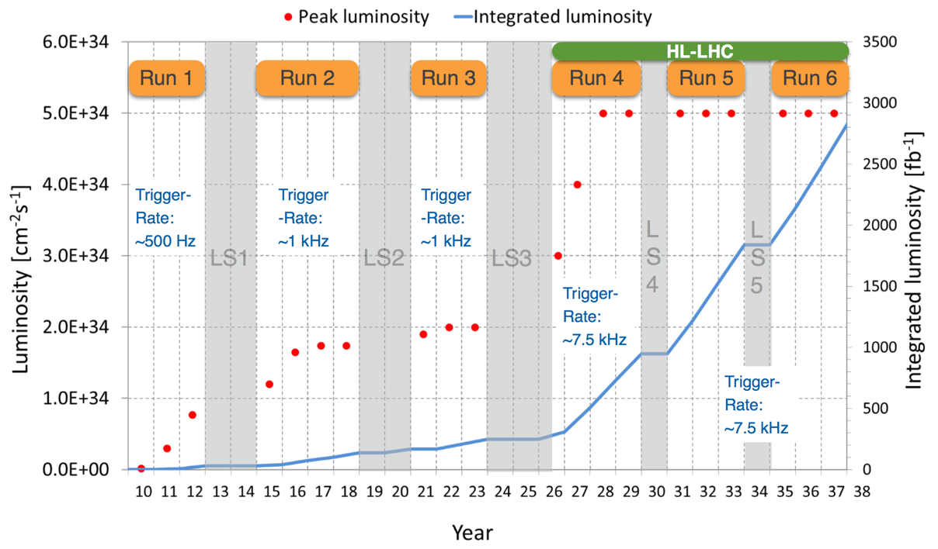
LHC Schedule
Run 3
Alice, LHCb upgrades
Run 4
ATLAS, CMS upgrades
O(10) times more events

Slide 40

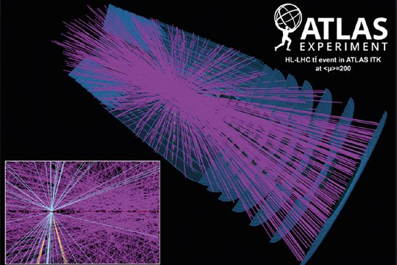
Events at HL-LHC: pile-up
Proton bunches (>10¹¹ protons/bunch)
CMS: event from 2017 with 78
reconstructed vertices
ATLAS: simulation for HL-LHC with 200 vertices

Slide 41
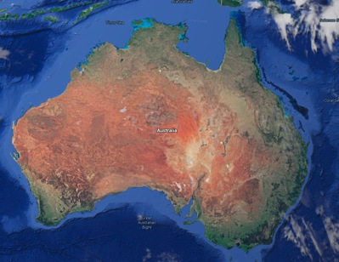

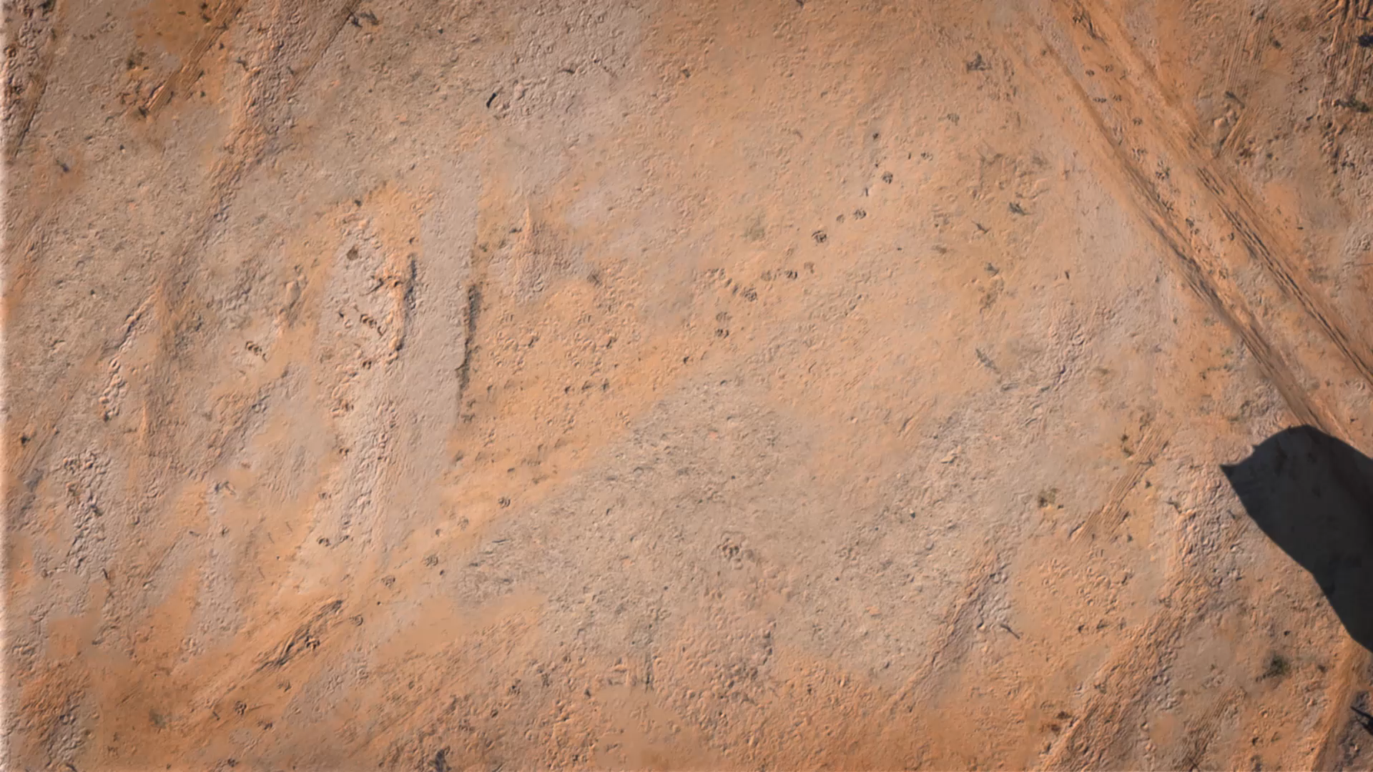
SKA - HQ in UK; telescopes in AU & SA
SKA1-LOW: 50 – 350 MHz
Phase 1: ~130,000 antennas
across 65km
SKA1-Mid: 350 MHz – 24 GHz
Phase 1: 200 15-m dishes across 150 km
Construction Phase 1: 2018 – 2024
Phase 2: mid-2020’s

Slide 42


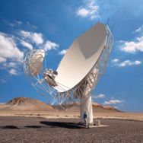
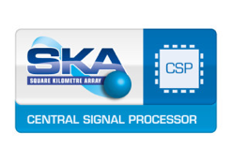


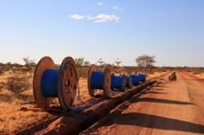
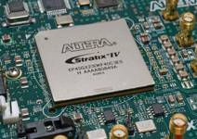

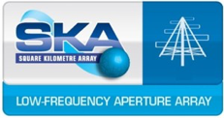
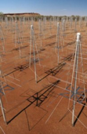
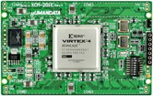
SKA Data Acquisition System Overview
8.8 Tbits/s
2x 5 Tbits/s
~50 PFlop
~250 PFlop
7.2 Tbits/s
300 PB/yr
SKA Regional Centres
2 Pbits/s

Slide 43
Regional Centre Concept:
Regional Centre 1
Users
Science Processing Centre
Users
Regional Centre 2
Users
AUS
Users
Science Processing Centre
Users
Users
RSA
Regional Centre N
Users
Observatory
User Community

Slide 44
Regional Centre Network

Slide 45
10 Billion of these

Slide 46
How do you manage all those data?
You need a Computing Model
I don not mean a Computer Model
I do not mean a Computational Model
Deciding to adopt Grid (Distributed) Computing is already a Computing Model choice
The Computing Model defines, among other things, how you organize your computing activities (your data, your processing)
We will work on defining a computing model this afternoon

